Slide 1

Elephant: A Wellness Trunk
A Final Demo
Medhashree Adhikari, Hyeyun Jung, Gabby Pruneda Turcios, Candice Lu
Notes:
Hi! We are Team Elephant! *Names*

Slide 2
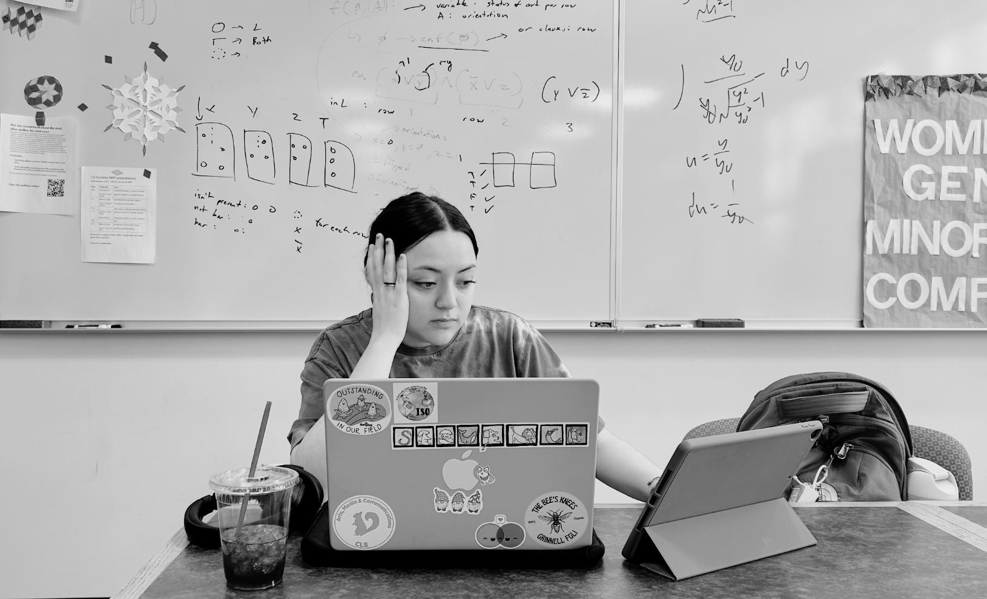
Introduction
Meet Sam, a typical, burnt out Grinnellian - they've been working for hours in front of a computer, maybe been procrastinating and then cramming against deadlines—all while striving to stay "productive". This “grind” culture, especially infamous at Grinnell, is normalized, but it's taking a toll on our mental and physical well-being, and we can attest.
Notes:
Team member: Gabby
Time: about 1 minute
Introduction of Elephant

Slide 3
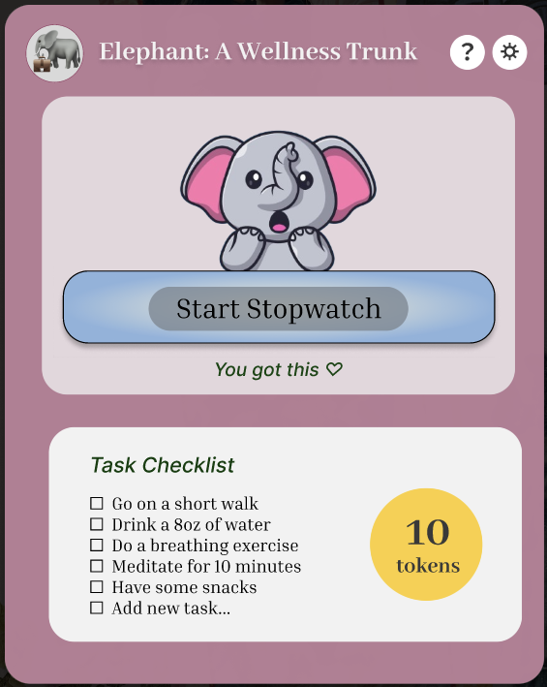
Meet Elephant: A Wellness Trunk, a user-friendly app designed to integrate wellness into your busy work routine—seamlessly and thoughtfully.
Notes:
Team member: Hyeyun Jung
Time: about 1 minute
Please meet Elephant: A Wellness Trunk, a user-friendly app designed to integrate wellness and mindfulness breaks into your daily routine, with tools to keep you on task and productive on your own terms with working environment tools like Pomodoro and stopwatch timers. In addition to this great addition to your daily scheduling/organizing, users can customize their widget to their own likes by collecting our sets of widgets avatars aesthetically made from commissioned local artists

Slide 4
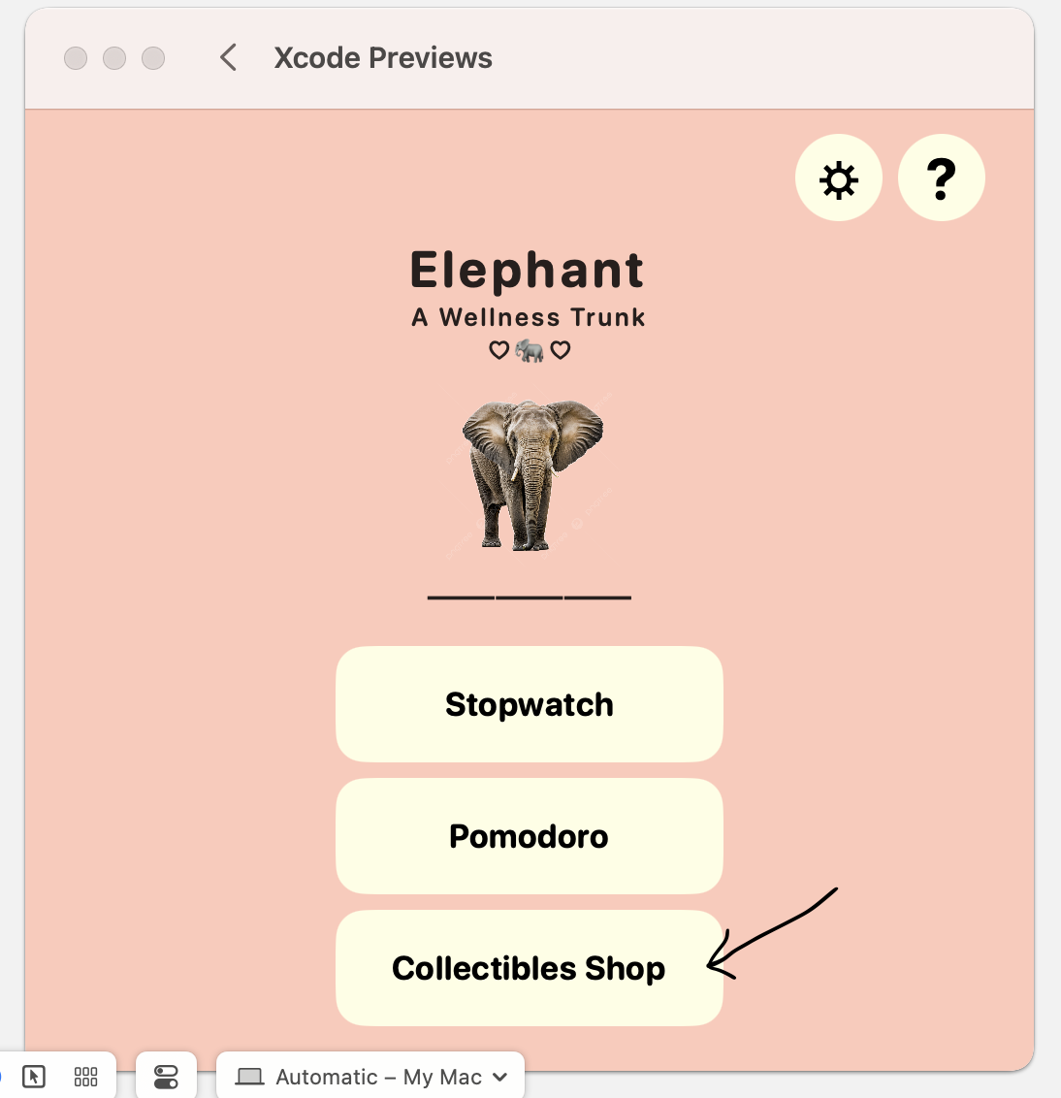
What is Elephant?
MacOS widget that incorporates:
Wellness to-do list
Pomodoro timer/stopwatch
Token reward system
Goals:
Incorporate wellness habits into working routines
Gamified mechanisms to incentivize users
Two components:
Main app: settings, token store, user manual
Widget: to-do list view, timer view with customizable avatar
Notes:
Team member: Gabby
Time: about 1 minute
A little more in-depth overview, what is it on, why use it, how to use it

Slide 5
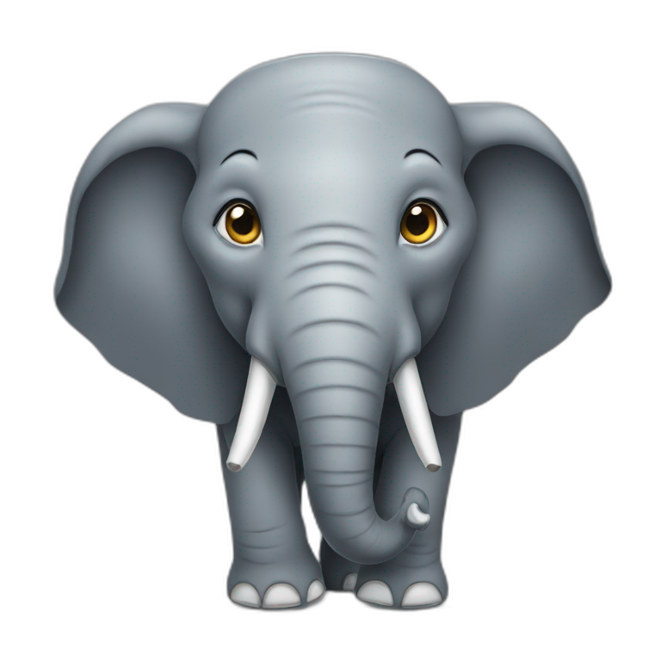
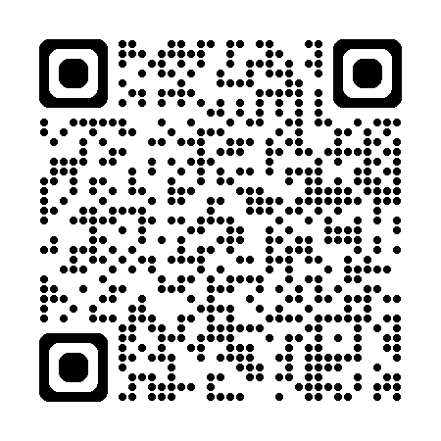
Let’s see how this gets done
with a quick demo…
for future reference: https://tinyurl.com/elephant-app25
Notes:
Team member: Mae
Time: about 5-7 minutes

Slide 6
Future Work
Immediate:
UI consistency
Minimal Viable Product
Fix Token System
Future:
Integration with ResLife
Apple Watch Compatibility: notifications & logging
Social: adding friends, exchanging tokens, sharing status
Collectible Accessories: seasonal accessories to add to tokens
OS: develop app available to more operating systems
Notes:
Team member: Candice
Time: about 1-2 minutes
[input what to say here]

Slide 7
324 Lessons
Mae: My GitHub navigation skills have significantly improved and with that I also learned how to break up work based on skill but also find opportunity to learn other skills simultaneously.
Candice: I learned a lot about thinking how to do things to make collaboration easier for others and prevent repeating each other's work, such as creating reproducible code, documenting, and communicating effectively
Gabby: I took a greater understanding of team developing from our group work and helping each other out (not only for the grade but our individual learning goals)
Hyeyun: I learned why structured collaborations with clear steps are roles are important. Without structure, it could be chaotic.
Team common lesson – communications are important!!!!
Notes:
Team member: everyone
Time: about 4-6
[input what to say here]

Slide 8
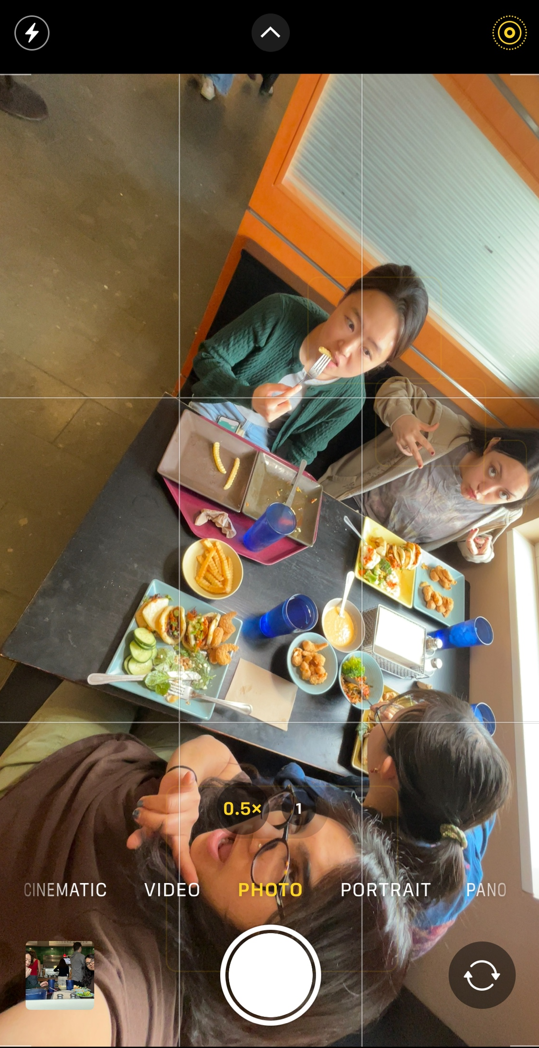
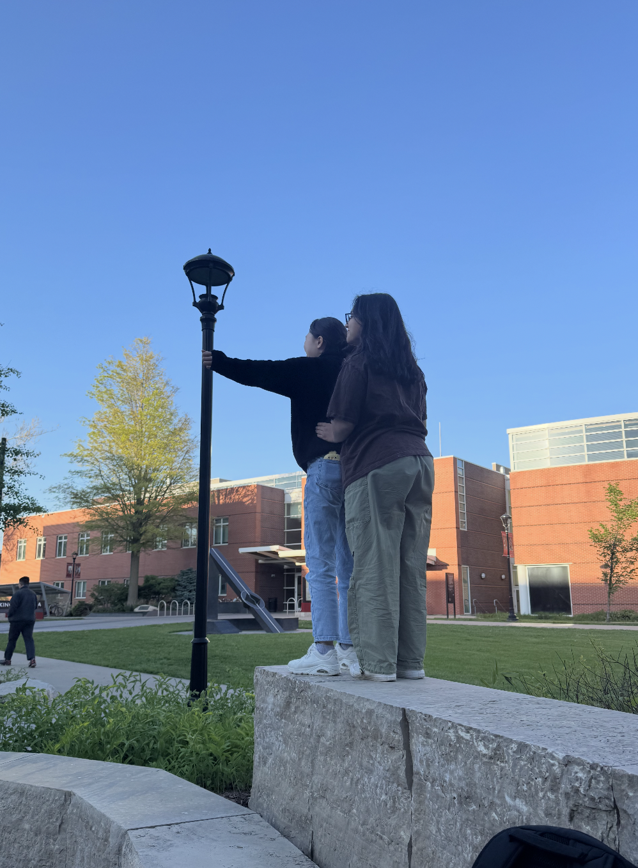
GROUP BONDING!
Notes:
Team member: everyone
Time: about 4-6
[input what to say here]

Slide 9
Thank you! Questions?
Team Elephant: Medhashree Adhikari, Hyeyun Jung, Candice Lu, Gabby Pruneda Turcios
Notes:
Thank you! Do we have any questions from our peers?

